Slide 1
Light GBM Algorithm
LightGBM stands for lightweight gradient boosting machines.

Slide 2
why Light GBM?
Fast
Distributed
High
performance

Slide 3
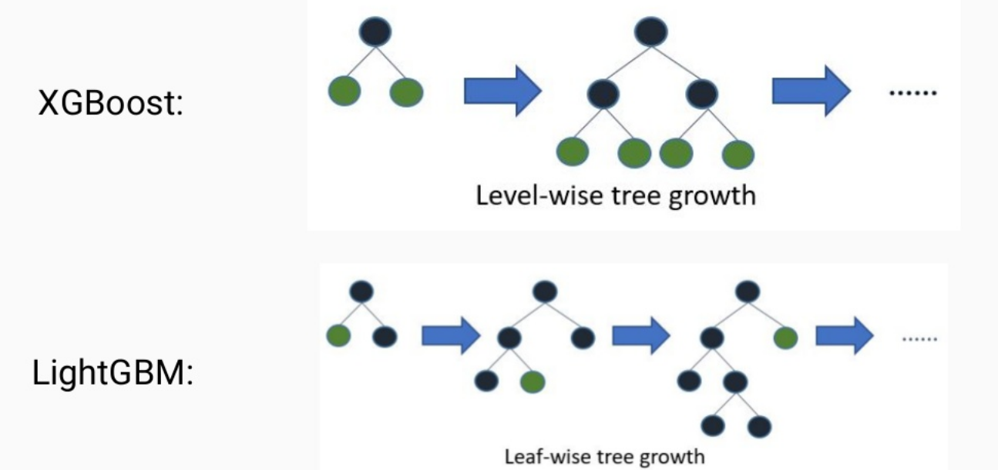
Difference in LightGBM and XGBoost:

Slide 4
Installation and Implementation:
pip install lightgbm

Slide 5
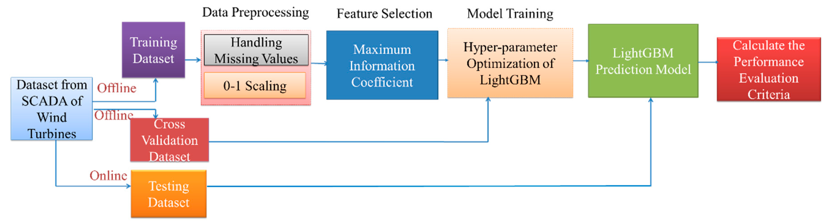
Example of Light GBM:

Slide 6
Advantages of LightBGM Model:
LightBGM Algorithm has faster speed and higher accuracy
It has lower Memory usage
It has better accuracy
It supports parallel and distributed GPU learning
It is capable of handling large scale data

